Slide 1
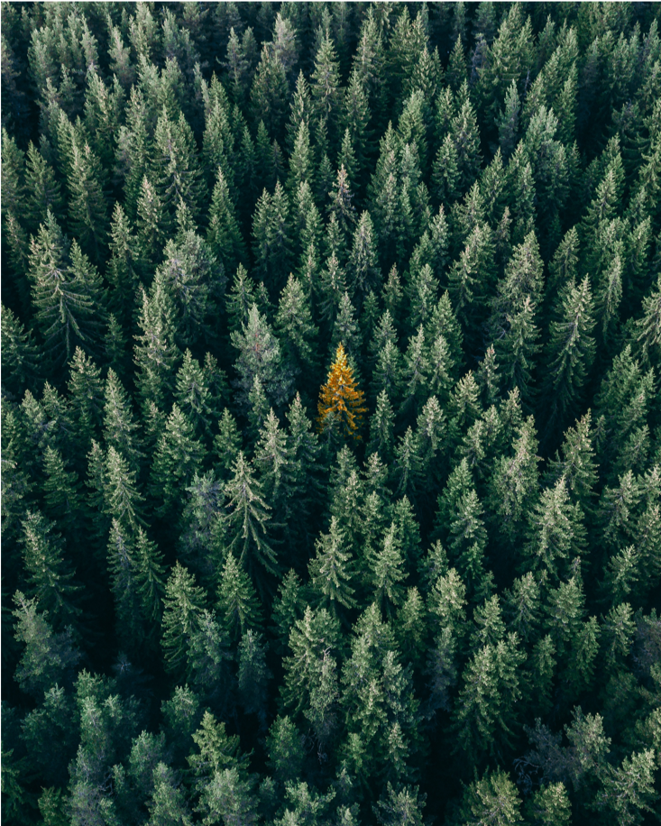
Trees of Copenhagen
Social data analysis and visualization
Project assignment A
Notes:
Eller denne her?

Slide 2
Idea
Inspiration from website
Tree data of Copenhagen
Help the city-planner or citizens
https://www.cloudred.com/labprojects/nyctrees/
Notes:
An explanation of the central idea behind your final project (what is the idea? which datasets do you need to explore the idea?, why is it interesting?)
Inspiration from an website displacing the trees in five neighbourghood in NY. So we want to make the same over CPH. Right now we have two datasets, of different sizes and with different features. (Choose one or merges?). It is interesting to see want we can find in the data. What patterns will reveal itself?
Be ready to safe the trees from corona.

Slide 3
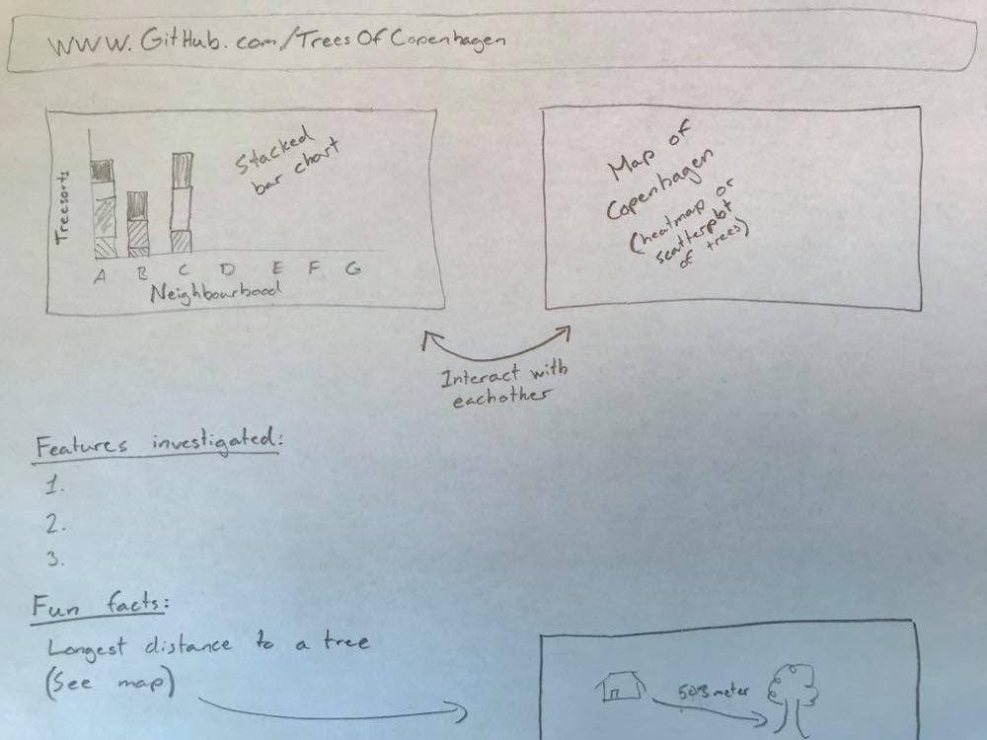
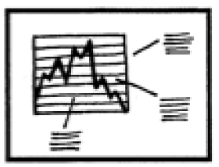
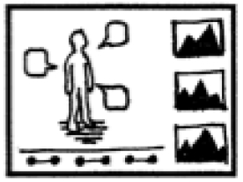
Visualization
Genre:
+
Notes:
Our goal is to build a website that is easy to interact with and display how the trees are distributed across the neighbourhoods of Copenhagen.
Genre: A mix between an annotated chart and a partitioned poster. Allows us to explore the data in the best way and to hopfully tell a fun and interesting story

Slide 4
Elements needed
Obtain the skills for combining interactive plots
Understanding how to host on Github
Exporting plots to HTML

Slide 5


Implementation plan
Preliminary Data analysis
Creating interactive plots
Converting to HTML
Hosting on Github.com

Slide 6
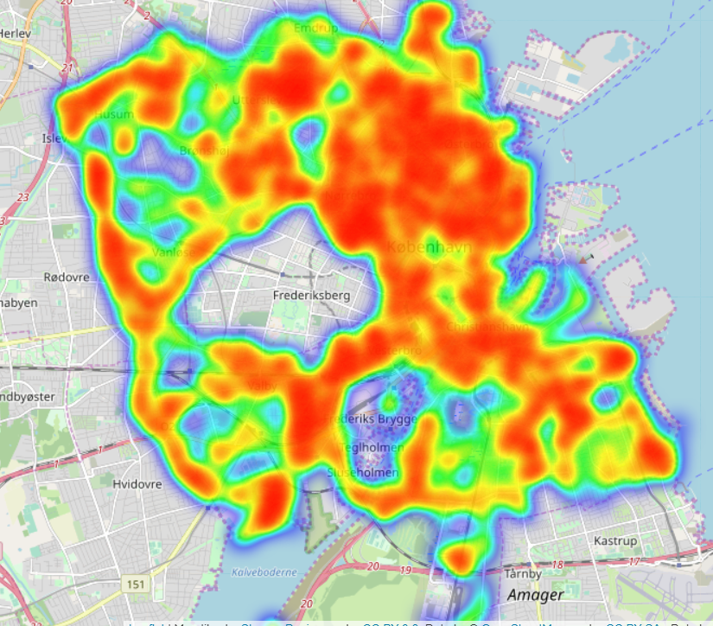
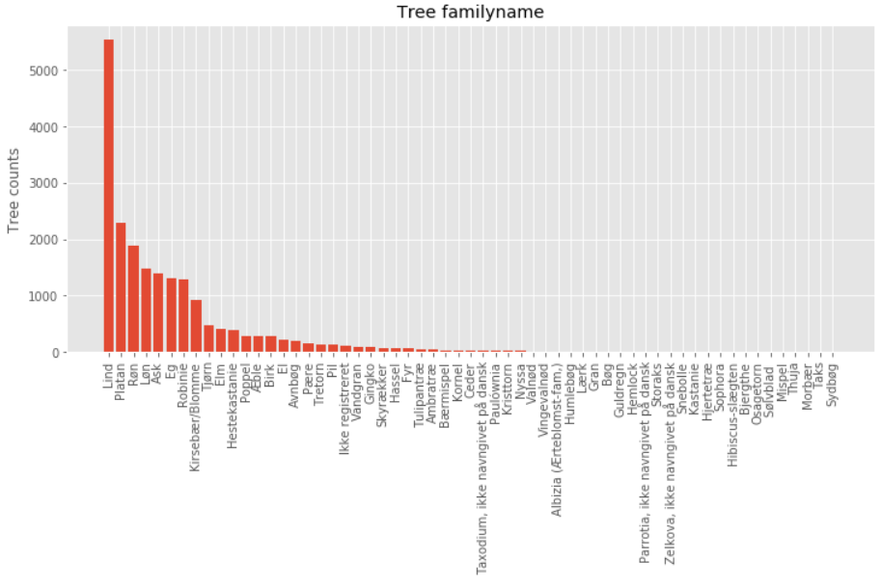
Preliminary data analysis

